Slide 1

CS2009 Design and Analysis of Algorithms
P and NP Hard Problems

Slide 2
Deterministic Vs. Nondeterministic
In deterministic algorithm, for a given particular input, the computer will always produce the same output going through the same states OR we know how each and every statement of algorithm is working OR result of every operation is uniquely defined as there is no choice
In non-deterministic algorithm, for the same input, the compiler may produce different output in different runs. In fact, non-deterministic algorithms can’t solve the problem in polynomial time and can’t determine what is the next step. The non-deterministic algorithms can show different behaviors for the same input on different execution and there is a degree of randomness to it. OR we don’t know how statements of algorithm are working OR result of every operation is not uniquely defined as there is choice

Slide 3
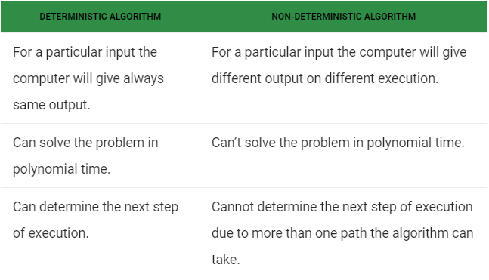
Deterministic Vs. Non deterministic

Slide 4
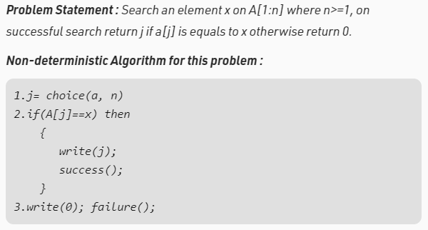
Deterministic Vs. Non deterministic

Slide 5
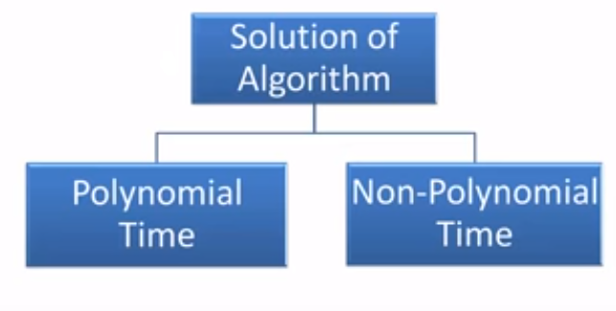
Course Supervisor : ANAUM HAMID

Slide 6
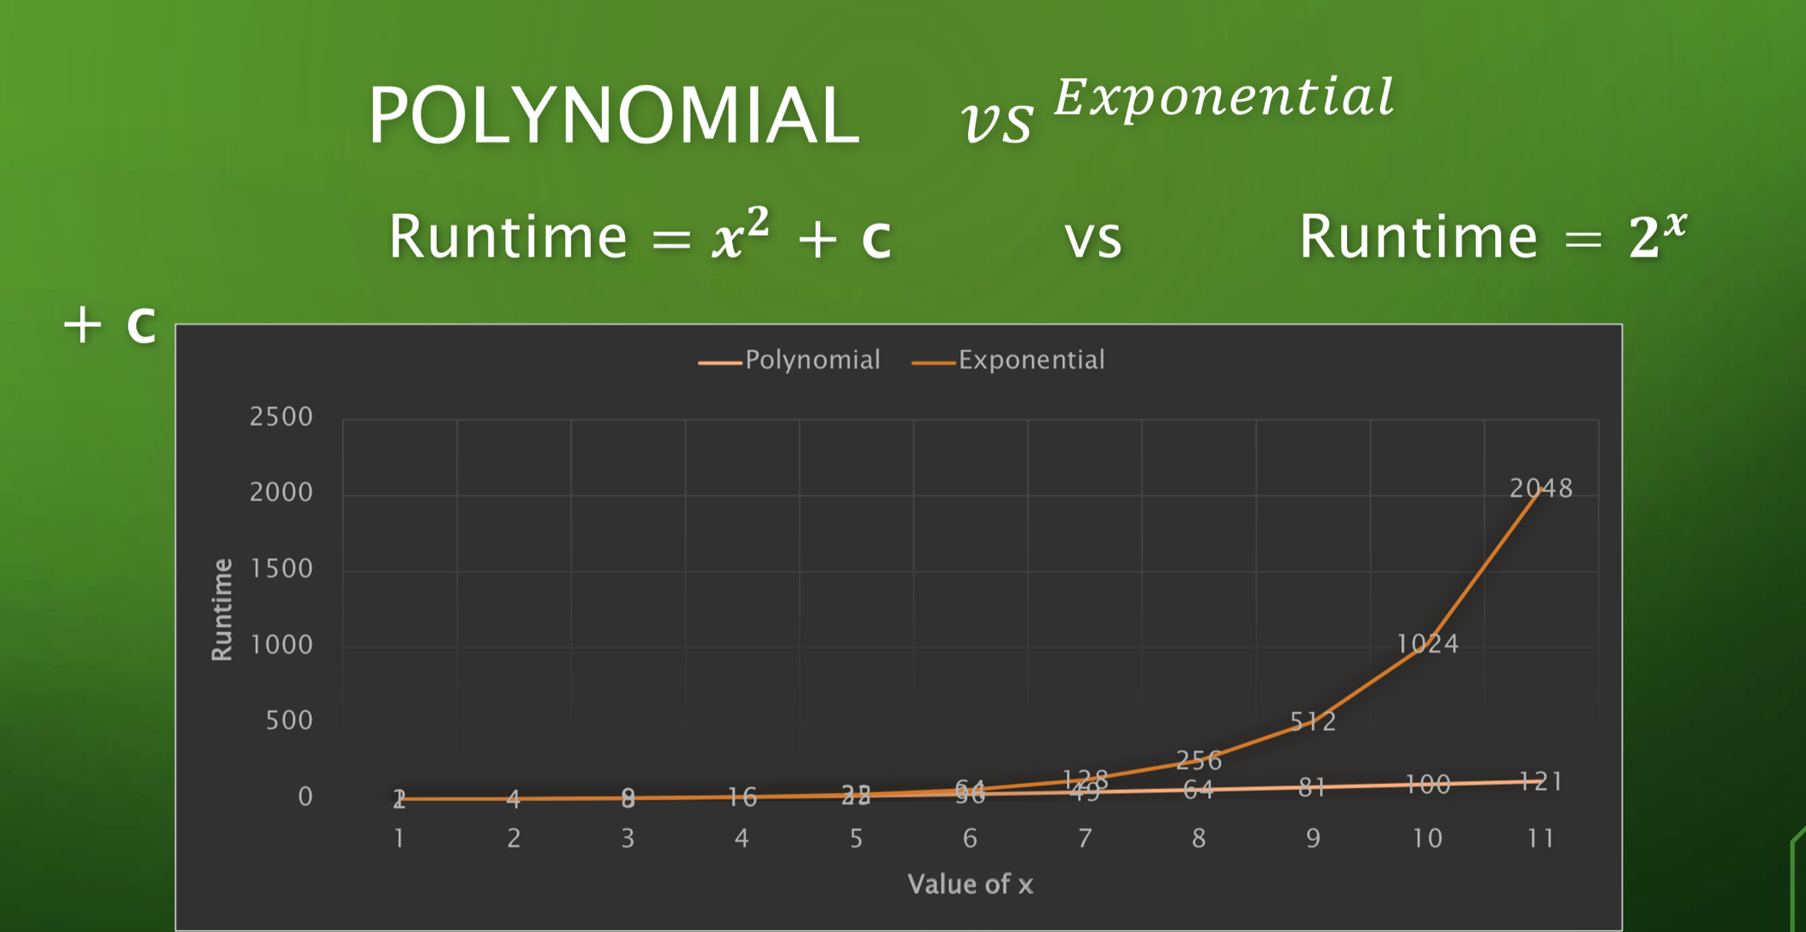
Polynomial VS Exponential
Course Supervisor : ANAUM HAMID

Slide 7
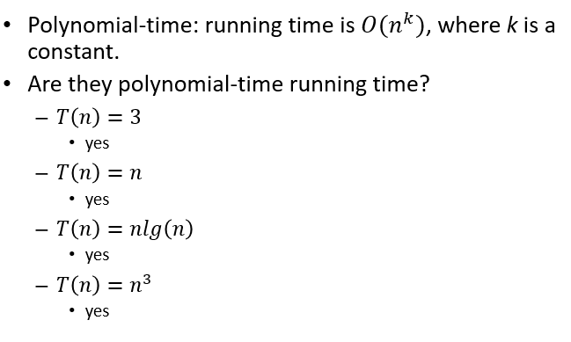
What is Polynomial time ?

Slide 8
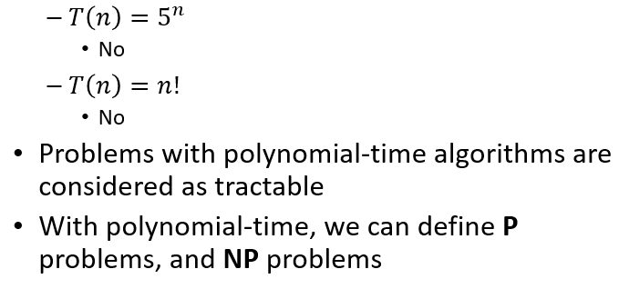
What is Polynomial time ?

Slide 9
Complexity Theory : P,NP,NP-Complete and NP-hard problems
We classify problems based on how hard they are to solve because some are easier to solve and some are not.
So, we can categorize problems in these 4 classes :
P class problems
NP class problems
NP-Complete Problems
NP hard problems

Slide 10
P problems (Polynomial time problems)
P class problems :
Problems that can be solved and verified in polynomial time. (easier to solve and verify)
OR
You can also say problems that are solvable and verifiable by deterministic Turing machine or in deterministic polynomial time
For example :
Is the given number prime or not ? What is LCM (least common multiple), GCD (greatest common divisor) of given numbers. These problems can be solved and verified in polynomial time

Slide 11
NP problems (Non-deterministic polynomial time problems)
NP class problems : (problems of unknown difficulty)
Problems that right now are not solvable in polynomial time but can be verified in polynomial time if the solution is given.
OR
You can also say that problems that are right now solvable in non-deterministic polynomial time (which means not solvable in polynomial time) but can be verified in deterministic polynomial time (which means verifiable in polynomial time).
For example :
Jigsaw puzzle

Slide 12

NP problems (Non-deterministic polynomial time problems)
Jigsaw puzzle : a puzzle consisting of small irregularly cut pieces that are to be fitted together to form a picture

Slide 13
NP problems (Non-deterministic polynomial time problems)
So in jigsaw puzzle, there are many possibilities to fill in the empty space so finding solution (complete picture) goes in non-polynomial time. Is there any faster way to solve that we don’t know right now!
But if you are given the solved Jigsaw (which means you are given complete picture that was formed by pieces) and you are asked to verify that it is correct or not then you can easily do this in polynomial time by just checking that every piece is properly connected to its neighbors.
So you noticed although problem is not solvable in polynomial time but can be verified in polynomial time. This is example of NP class problem

Slide 14
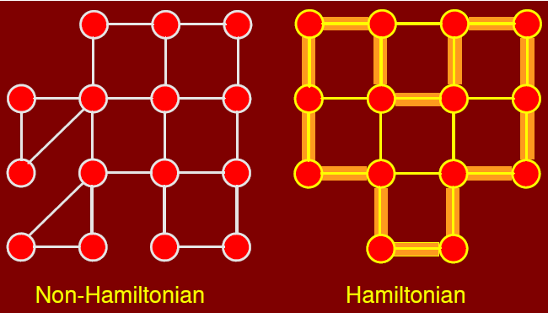
NP problems (Non-deterministic polynomial time problems)
Another example of NP class could be of “Detecting Hamiltonian cycle”
Given an undirected graph G, does G have a cycle that visits every vertex exactly once?
There is no known polynomial time algorithm for solving this problem since there are n! possible cycles in general. However, if we are given a cycle and we need to verify in polynomial time if it is a legal cycle then we can. So, it is NP problem

Slide 15
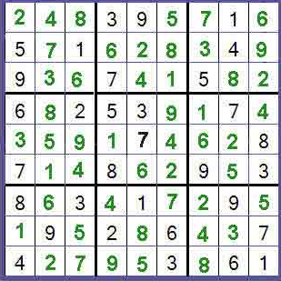
NP problems (Non-deterministic polynomial time problems)
Another example is Sudoku game :
The classic Sudoku game involves a grid of 81 squares. The grid is divided into nine blocks, each containing nine squares. The rules of the game are simple: each of the nine blocks has to contain all the numbers 1-9 within its squares. Each number can only appear once in a row, column or box.
It is not solvable in polynomial time but can be verified easily in
polynomial time by checking if any number is appearing twice in row,
column or box. So, it is also NP problem.

Slide 16
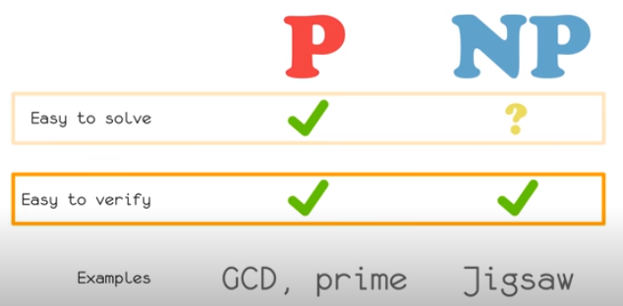
P vs NP

Slide 17
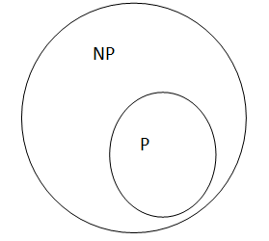
P vs NP
Observe that P is subset of NP. In other words, if we can solve a problem in polynomial time, we can certainly verify the solution in polynomial time.
However, it is not known whether P = NP. It seems unreasonable to think that this should be so. Being able to verify that you have a correct solution does not help you in finding the actual solution. The belief is that P is not equal to NP, but no one has a proof for this.

Slide 18
P vs NP
Most say P is not equal to NP and give reasons in a way the world works.
For example, I give two different tasks to two different persons
Task1 : I give first person a question to solve
Task2: I give second person solution of question and ask him to verify the solution
Of course task1 is more difficult than task2. However if P=NP then that would mean both tasks would have same complexity which is not the case here.

Slide 19

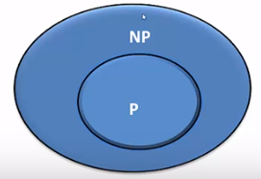
P & NP Class
P is a set of all decision problems solvable by a deterministic algorithm in polynomial time. NP is the set of all decision problems solvable by a nondeterministic algorithm in polynomial time.
Course Supervisor : ANAUM HAMID

Slide 20
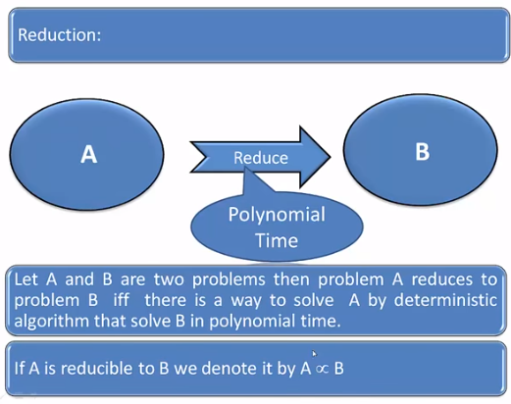
Reduction
Course Supervisor : ANAUM HAMID

Slide 21
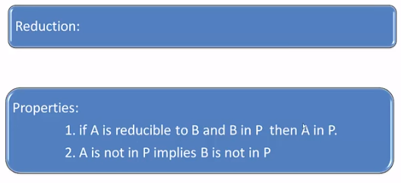
Reduction
Course Supervisor : ANAUM HAMID

Slide 22
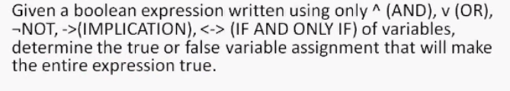
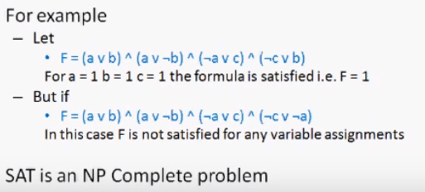
What is Boolean Satisfiability?
Course Supervisor : ANAUM HAMID

Slide 23

3 SAT
3-SAT (Boolean satisfiability problem) Problem is known NP-Complete problem in which all other NP problems can be reduced. It is problem of determining whether given Boolean formula is satisfiable or not. Eg.
Are there any Boolean values of x1…..x6 that will evaluate whole expression to true !
Course Supervisor : ANAUM HAMID

Slide 24
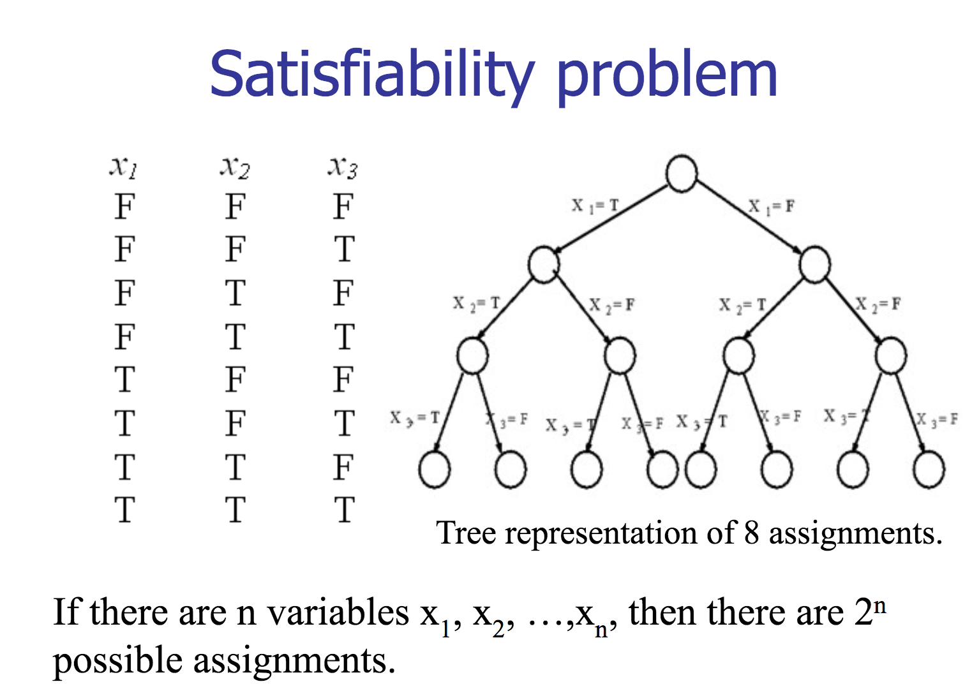
Course Supervisor : ANAUM HAMID

Slide 25
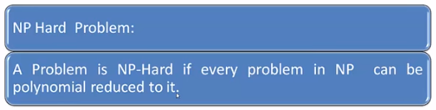
NP Hard
Course Supervisor : ANAUM HAMID

Slide 26
NP Hard
Course Supervisor : ANAUM HAMID

Slide 27
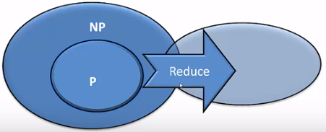
NP Hard
Course Supervisor : ANAUM HAMID

Slide 28
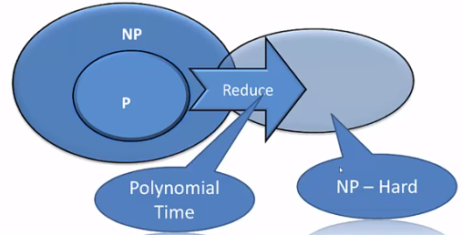
NP Hard
Course Supervisor : ANAUM HAMID

Slide 29
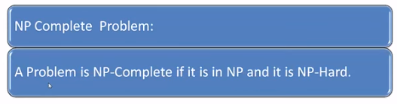
NP Complete
Course Supervisor : ANAUM HAMID

Slide 30
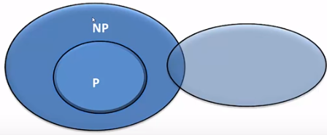
NP Complete
Course Supervisor : ANAUM HAMID

Slide 31
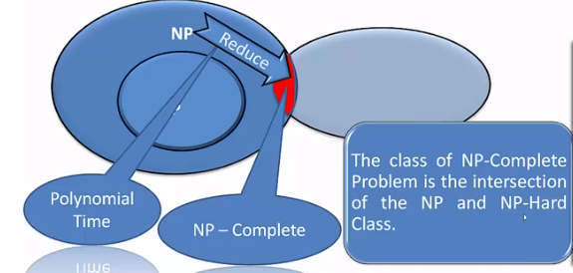
NP Complete

Slide 32
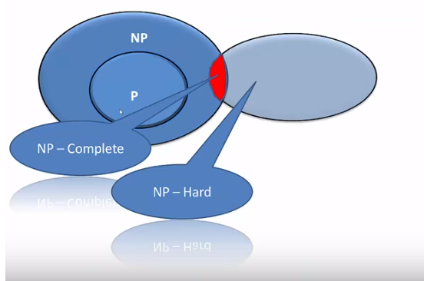
NP Hard & NP Complete
Course Supervisor : ANAUM HAMID

Slide 33
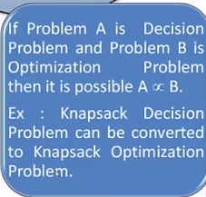
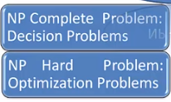
NP Hard & NP Complete

Slide 34
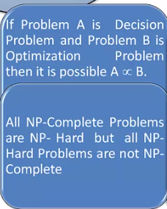
NP Hard & NP Complete
Course Supervisor : ANAUM HAMID

Slide 35
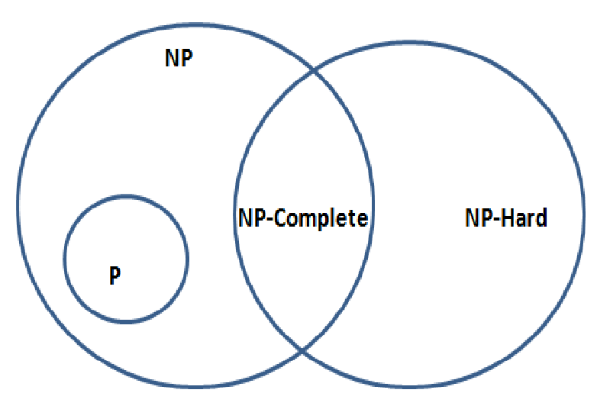
NP-Complete Problems (NPC Problems)
NP-Complete problems are those problems “X” such that all other NP problems can be reduced to X. This means if we can solve NPC problems then we can solve all NP problems.
NP-complete problems are both NP and NP hard.
Known for 30-40 years and no one managed to solve them
3-SAT (Boolean satisfiability problem) Problem is known NP-Complete problem in which all other NP problems can be reduced. It is problem of determining whether given Boolean formula is satisfiable or not. Eg.
Are there any Boolean values of x1…..x6 that will evaluate whole expression to true !

Slide 36
NP-Hard Problems
A problem X is NP-hard, if there is an NP-complete problem Y, such that Y is reducible to X in polynomial time.
Problems that are at least as hard as NP complete problems. These are the hardest problems of all. NP hard problems may or may not be in NP.
If an NP-Hard problem can be solved in polynomial-time, then ALL NP problems can be solved in polynomial-time (and hence P = NP). So it is widely believed that NP-hard problems are NOT polynomial-time solvable.
Or we can also say that the problem in NP-Hard cannot be solved in polynomial time, until P = NP. If a problem is proved to be NPC or NPH, there is no need to waste time on trying to find an efficient algorithm for it. Instead, we can focus on design approximation algorithm.
Examples are travelling salesman problem, vertex cover problem, halting problem etc that we will see later.

Slide 37
Final Summary
P-class Problems : solvable and verifiable in polynomial time
NP class problems : not solvable in polynomial time but verifiable
NP-Complete problems : if every NP problem can be reduced to problem X then X is NP-complete
NP Hard problems : if every NPC problem can be reduced to problem X then X is NP-hard.

Slide 38
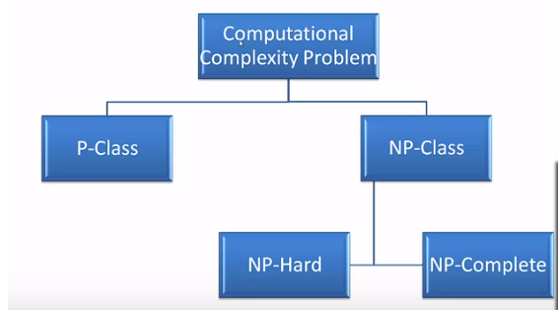
Course Supervisor : ANAUM HAMID

